Slide 1

Nike Inc. Stock Return and Portfolio Analysis
This report quantifies Nike's performance, systematic risk, and portfolio diversification benefits from May 2022 to April 2025.

Slide 2
Research Methodology and Data Foundation
Analysis Framework
Data Sources and Risk-Free Rate
This study analyzes Nike Inc. (NKE US Equity) performance against the S&P 500 Index over a 36-month period from May 2022 to April 2025. We use monthly stock price and dividend data to provide a comprehensive view of total shareholder return.
Primary Data Source: Bloomberg Terminal
Official closing prices (adjusted for corporate actions)
Dividend per share
Market index returns
The analysis period captures Nike's performance through significant macroeconomic shifts, including post-pandemic recovery, inflationary pressures, and market normalization.
Risk-Free Rate: 0.3611% monthly (3-month T-bill average).
This rate is essential for calculating excess returns and evaluating Nike's compensation for systematic risk exposure.

Slide 3
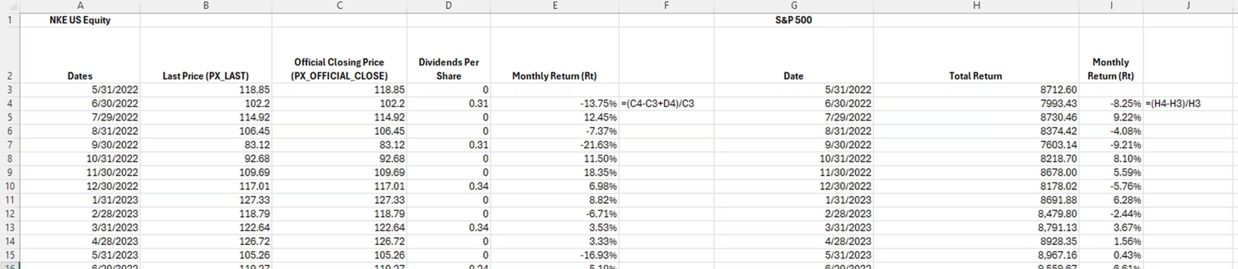
Monthly Return Calculations and Methodology
Monthly returns were calculated using the total return formula, which incorporates both price changes and dividend income:
Where: r_t = monthly return in period t, P_t = closing price in period t, P_{t-1} = prior month closing price, D_t = dividends paid in period t
This formula captures the complete economic return to equity holders, including dividends. For non-dividend months, only price appreciation is measured; Nike's consistent quarterly dividends were integrated into monthly aggregations as relevant.
Official closing prices from Bloomberg prevent distortions from intraday volatility and corporate actions, as adjustments for stock splits and other capital transactions are automatically applied.

Slide 4
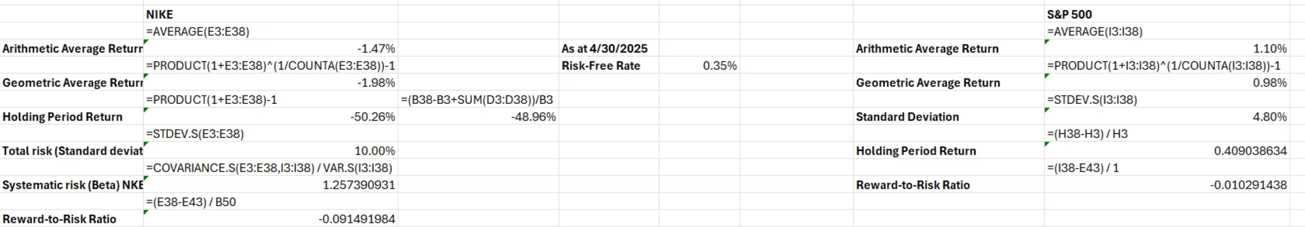
Nike's Return Performance: Arithmetic, Geometric, and Holding Period Returns
Three complementary measures reveal Nike's significant underperformance during the analysis period:
-1.47%
-1.98%
-50.26% / -48.96%
Arithmetic Average Return
Geometric Average Return
Holding Period Return
Monthly average, incorporating all return observations equally
Compound monthly return reflecting actual wealth accumulation
Cumulative three-year return: investor would lose over half initial capital
These return measures collectively highlight Nike's significant underperformance. The arithmetic average of -1.47% indicates consistent monthly losses, while the more negative geometric average of -1.98% underscores the compounding impact of these losses. A -50.26% holding period return confirms a substantial wealth destruction over the three-year analysis, revealing a dramatic decline in investor value.
The compounded method (-50.26%) assumes dividends are reinvested into the stock monthly, compounding effects on the investment base. In Nike's declining market, this amplifies losses as reinvested amounts face further price drops.
The simple method (-48.96%) treats dividends as non-reinvested cash, adding total dividends ($4.26) to the price change without compounding, resulting in a less negative return.

Slide 5
Risk Analysis: Total and Systematic Risk Profiles
Nike exhibits substantially elevated risk compared to the broader market:
Total Risk (Standard Deviation)
Systematic Risk (Beta)
Nike: 10.00% monthly (120% annualized)
S&P 500: 4.80% monthly (58% annualized)
Nike's total risk is 2.08 times the market. This reflects volatility from supply chain issues, competitive pressures, and inventory challenges.
Nike's beta of 1.2574 classifies it as an aggressive stock, amplifying market movements by 26%. This elevated systematic risk indicates high sensitivity to overall economic conditions and market sentiment.

Slide 6
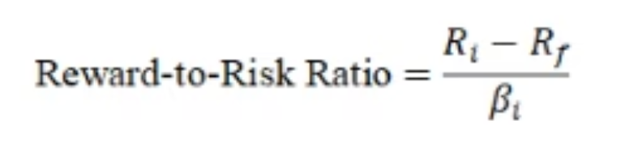
CAPM Valuation and the Reward-to-Risk Ratio
The Capital Asset Pricing Model evaluates if expected returns compensate investors for systematic risk exposure. The Treynor Ratio compares excess return per unit of systematic risk:
Nike's Treynor Ratio
Market Portfolio Treynor Ratio
Calculation: (-1.47% - 0.36%) / 1.2574 = -0.0145
Calculation: (1.10% - 0.36%) / 1.0 = 0.0074
Interpretation: Negative excess returns, indicating inadequate compensation for market sensitivity.
Interpretation: Positive reward-to-risk, compensating investors for systematic risk.
Pricing Decision: OVERPRICED
Nike's negative Treynor Ratio, compared to the market's positive ratio, indicates overpricing under CAPM. The stock provided negative excess returns despite bearing above-market systematic risk, violating risk-return equilibrium.

Slide 7
Comparative Performance: Nike vs. S&P 500 Market Portfolio
Metric
Nike (NKE)
S&P 500
Difference
Arithmetic Avg. Return
-1.47%
1.10%
-2.57%
Geometric Avg. Return
-1.98%
0.98%
-2.96%
Holding Period Return
-50.26%
40.90%
-91.16%
Total Risk (SD)
10.00%
4.80%
5.20%
Systematic Risk (Beta)
1.2574
1.0000
0.2574
Treynor Ratio
-0.0145
0.0074
-0.0219
Key Findings: Nike significantly underperformed the market over three years, delivering 91.16 percentage points lower returns with 5.20 percentage points higher volatility. This unfavorable risk-return profile is driven by company-specific headwinds: supply chain issues, intense competition, inventory corrections, and valuation mean reversion.

Slide 8
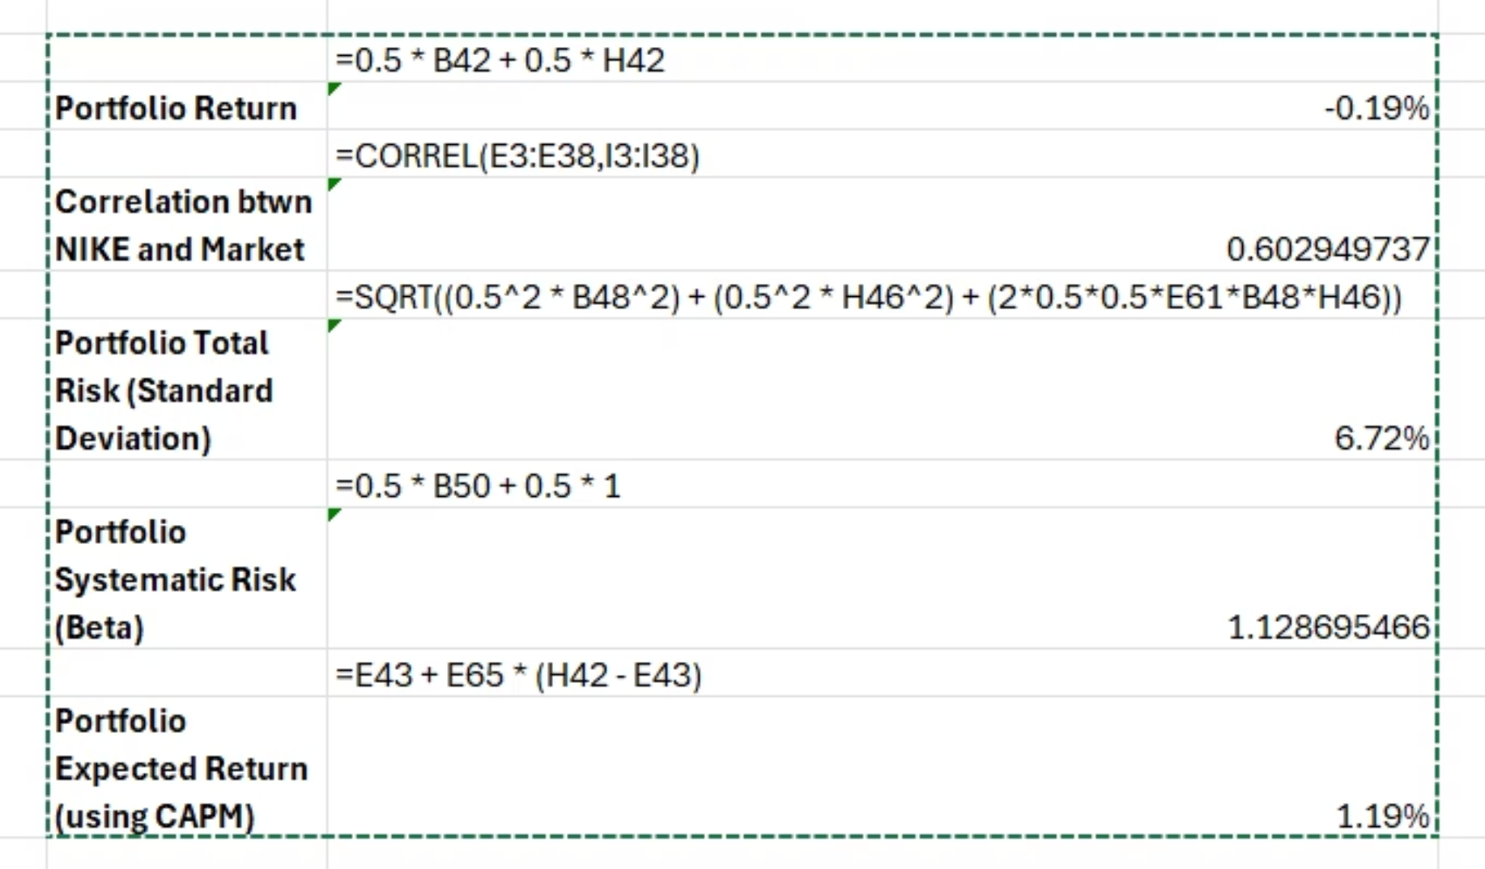
Portfolio Construction: 50% Nike / 50% S&P 500
Combining Nike with the market portfolio demonstrates significant diversification benefits:
1
Return Improvement
2
Risk Reduction
Arithmetic Average: -0.19% (vs. Nike's -1.47%)
Portfolio Correlation (Nike): 0.6029
Geometric Average: -0.41% (vs. -1.98%)
Total Risk: 6.72% (vs. Nike's 10.00%)
Holding Period Return: -13.36% (vs. Nike's -50.26%)
Systematic Risk (Beta): 1.1287 (vs. 1.2574)

Slide 9
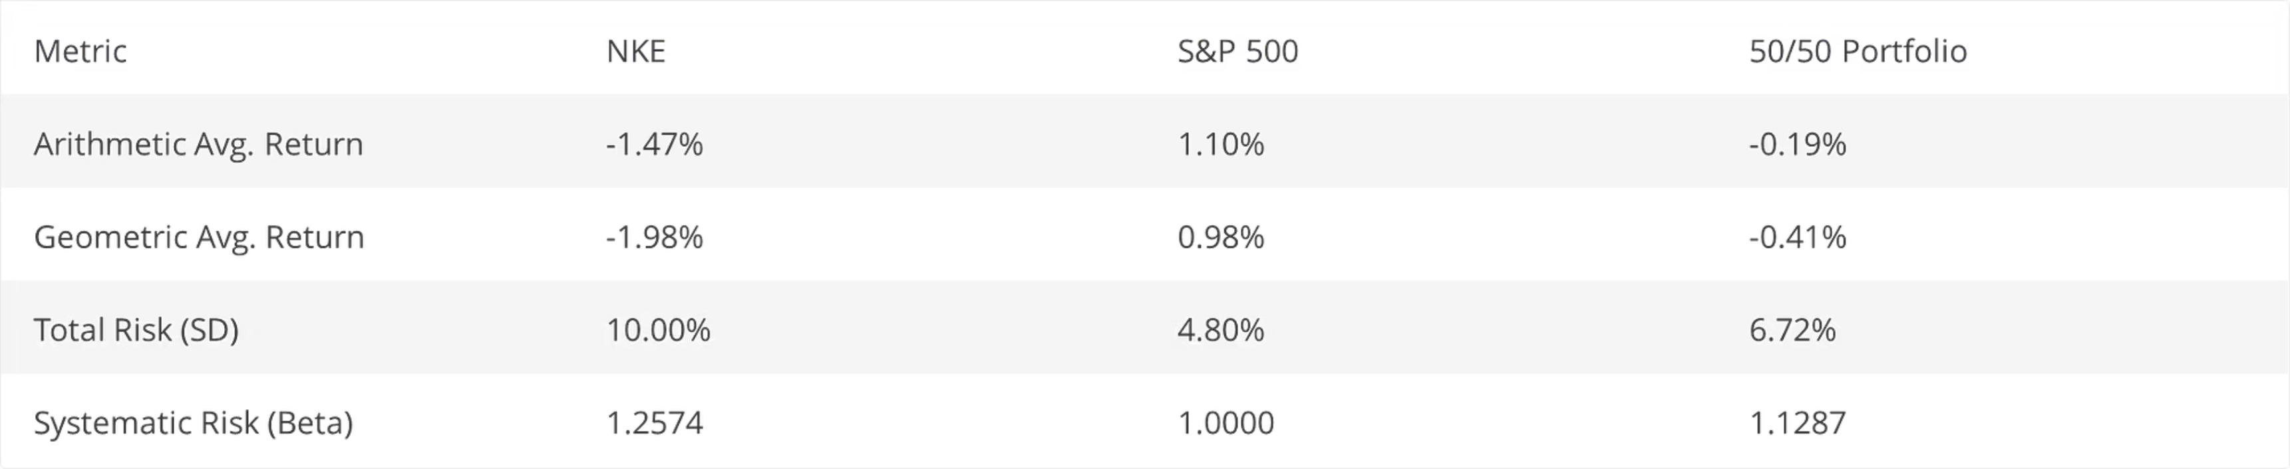
Portfolio Analysis: Performance Metrics Comparison
This three-way comparison highlights the effectiveness of portfolio construction in managing underperforming assets:
Portfolio's arithmetic average return (-0.19%) and geometric average (-0.41%) are less negative than Nike's, benefiting from the market's positive contributions. Risk metrics also enhance: total risk decreases to 6.72% through diversification (aided by the 0.60 correlation), and beta drops to 1.1287, approaching market levels. Overall, the portfolio demonstrates diversification's benefits, yielding a more stable risk-return profile by offsetting Nike's underperformance and high risk with the market's stability, aligning with portfolio theory principles.

Slide 10
Strategic Conclusions and Investment Implications
This analysis reveals key insights for investment decision-making and portfolio management:
1
2
Nike's Underperformance
Inadequate Risk Compensation
Nike's -50.26% return versus the market's +40.90% represents a 91-percentage-point gap, driven by company-specific risks and fundamental business challenges.
Nike's 1.26 beta indicates 26% above-market volatility, yet delivered negative excess returns. The -0.0145 Treynor Ratio suggests CAPM mispricing, with investors uncompensated for systematic risk.
3
4
Diversification Benefits
Arbitrage Opportunity
The 50/50 portfolio reduced total risk from 10.00% to 6.72% while limiting losses to -13.36%. This demonstrates diversification's practical value in mitigating concentration risk and providing downside protection.
Nike's negative reward-to-risk ratio identifies a potential arbitrage: short-selling Nike and going long on the diversified market portfolio. This strategy exploits CAPM mispricing until market efficiency restores equilibrium.

